Slide 1
WELCOME
Analysis Report on Swiggy's Operational and Financial Performance in Bangalore Using Dashboard Insights: An In-depth Analysis of Key Metrics and Trends
By Omkar Mitter

Slide 2
Introduction
Purpose of the Report
Provide a comprehensive analysis of Swiggy's operational and financial performance in Bangalore.
Utilize dashboard insights to uncover key metrics and trends.
Inform strategic decisions to enhance Swiggy's overall performance.
Scope of Analysis
Focus on key performance metrics:
Total Revenue
Average Order Price
Average Delivery Time
Revenue Distribution by Area
Food Category Popularity
Offer a holistic view of Swiggy's market presence and customer preferences.

Slide 3
Dataset Description
Source of Data
Swiggy, an online food ordering and delivery platform.
Dataset encompasses key operational and financial metrics.
Key Metrics Analysed
Total Revenue - Overall income generated from orders.
Average Order Price - The mean price of individual orders.
Average Delivery Price - The typical duration from order placement to delivery.
Revenue by Area - Revenue distribution across different localities of Bangalore.
Food Category Popularity - Preferences and frequency of orders for various food categories.
Purpose of Dataset
To understand Swiggy's performance and customer behavior.
To identify trends and patterns for strategic decision-making.

Slide 4
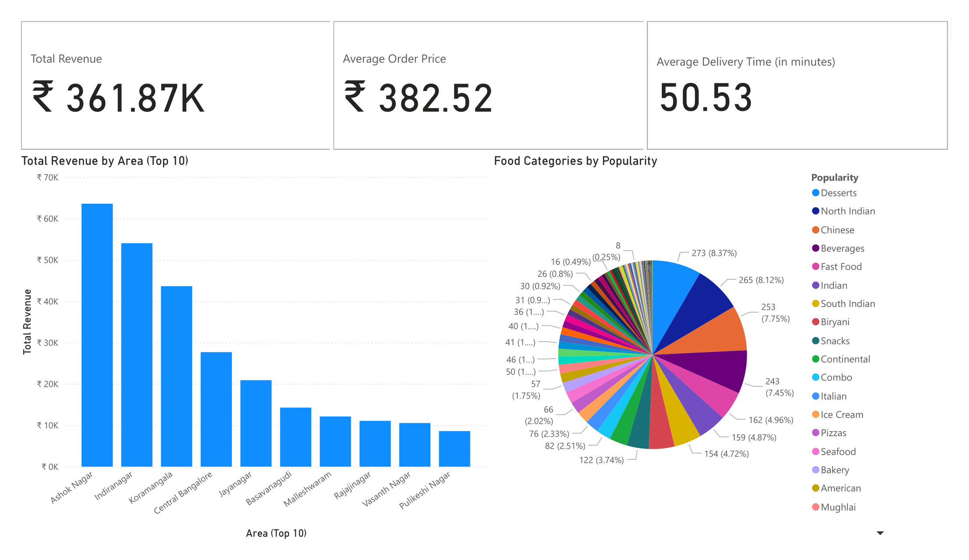

Slide 5
Total Revenue Analysis
Total Revenue - ₹ 361.87K.
Key Findings
Overall Performance
The total revenue indicates strong business performance.
Implications
Reflects Swiggy's ability to generate income and sustain operations.
Helps in assessing the effectiveness of marketing and sales strategies.

Slide 6
Average Order Price Analysis
Average Order Price: ₹ 382.52.
Key Findings
Customer Spending
The average order price indicates the typical amount customers are willing to spend per order.
Revenue Impact
A higher average order price can contribute positively to overall revenue.

Slide 7
Average Delivery Time Analysis
Average Delivery Time: 50.53 minutes.
Key Findings
Customer Experience
The average delivery time directly affects customer satisfaction.
Longer delivery times may lead to negative reviews and reduced repeat business.
Operational Efficiency
Averages provide insights into the efficiency of the delivery process.
Identify potential bottlenecks in the delivery system.

Slide 8
Revenue by Area
Key Findings
Geographical Distribution
Significant revenue generation from specific areas.
Ashok Nagar and Indiranagar are the highest revenue contributors.
Market Penetration
Strong market presence in top-performing areas.
Indicates successful penetration and customer base in these regions.
Growth Opportunities
Potential to increase revenue in lower-performing areas.
Targeted marketing and promotional activities could boost sales in these regions.
Resource Allocation
Inform strategic allocation of resources based on revenue distribution.
Focus on enhancing services and marketing efforts in top revenue-generating areas.

Slide 9
Food Categories by Popularity
Key Findings
Customer Preferences
High demand for Desserts, North Indian, and Chinese cuisines.
Indicates customer taste trends and preferences.
Sales Impact
Popular food categories significantly contribute to overall sales.
Leveraging popular categories can enhance revenue.
Marketing Strategies
Opportunity to promote less popular categories through special offers.
Tailored marketing campaigns can increase visibility and sales of diverse categories.
Menu Optimization
Insights for optimizing the menu to align with customer preferences.
Potential to introduce new items or variants in popular categories to attract more customers.

Slide 10
THANK YOU

